Slide 1

G
R
O
U
P
Cam Refinance
Progress Report
06

Slide 2
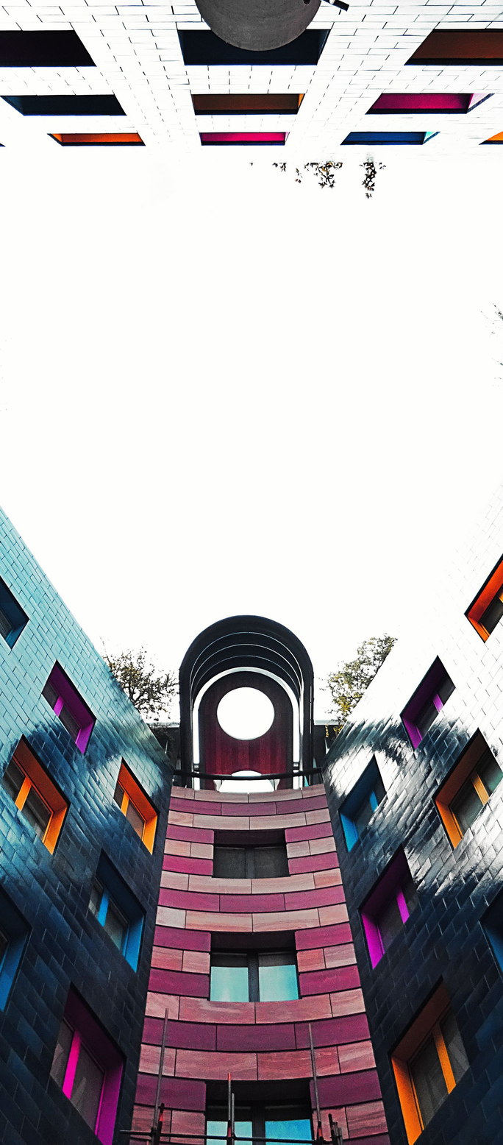
Group members
ID: E20200353
KOH TITO
ID: E20200054
LAY CHHAY
ID: E20200129
DORN DAWIN
Cam refinance Group 6
ID: E20200014
LAB THAVRITH
ID: E20201218
HUN SOKRARITH

Slide 3

Progress Table
About Bank Information
About Selling House Information
Project's flow
Next Step

Slide 4
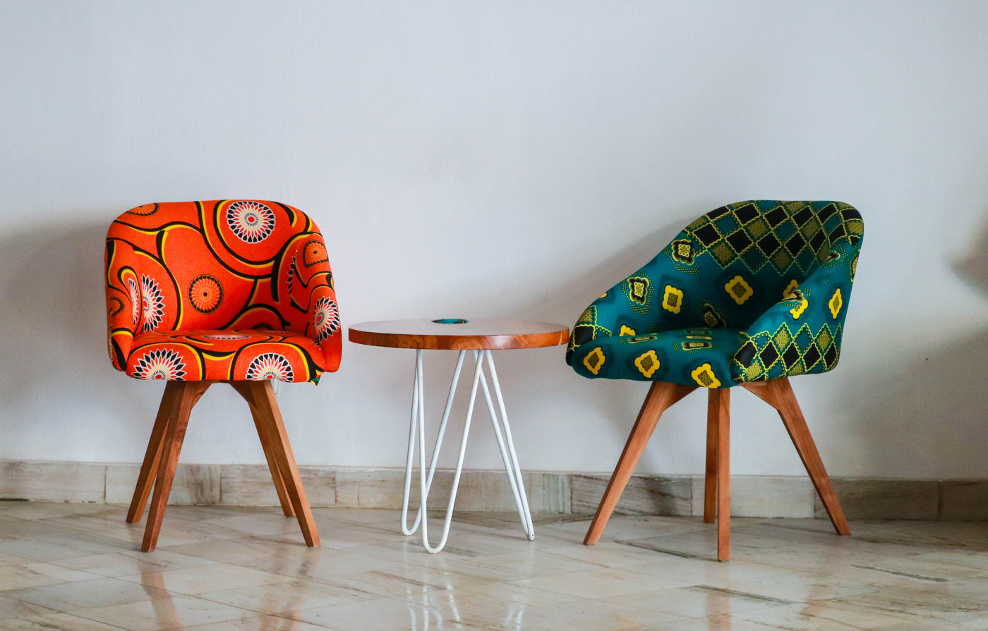
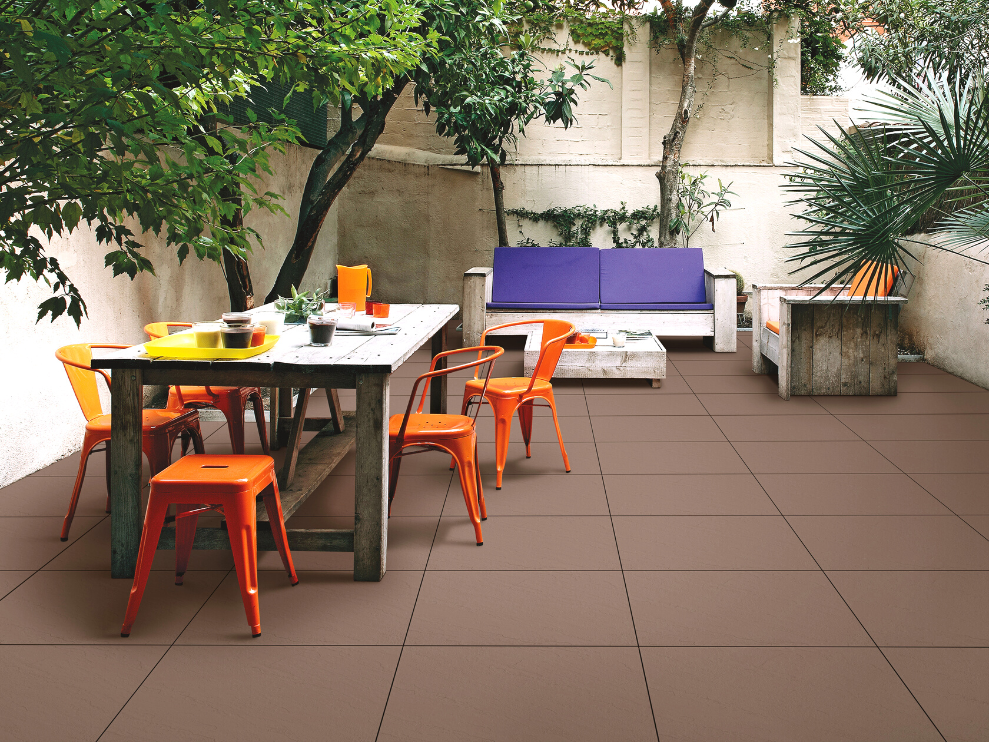
About Bank Information
Our team has split into 2 teams in order to gather some information for this project. First thing we do is to collect as much as information related to home loan from various bank.
LAY Chhay, HUN Sokrarith and DORN Dawin have found some of the important information.
01

Slide 5
Here are some data needed for our project
Canadia
ABA
VATTANAC
Housing loan info
Housing loan info
Housing loan info
LOAN SIZE, LOAN PERIOD, AND INTEREST RATE:
Loan size up to US$ 300000 but not more than 70% of the house price.
Maximum the loan period is 25 years for:
Customers who are currently employed by public organizations, national or international agencies, and will not exceed the retirement age.
Other customers who have good health and will not be over 60 years of age (start from receiving the loan until the end of the loan period).
In the first year interest rate is 6.88% but in the second year is 7.88 per year.
CUSTOMER REQUIREMENTS:
Any Cambodian who is a majority
Having a proper work, salary, or business
Having good history, reputation, attitude, and willingness to pay back to Canadia Bank
Having a permanent address that is certified by the local authority
Having identity documents which are ID cards, family books, etc.
LOAN SIZE, LOAN PERIOD, AND INTEREST RATE:
Loan size up to US$ 5000 to US$ 200,000 but not more than 70% of the house price.
Maximum the loan period is 10 years for:
Customers who are currently employed by public organizations, national or international agencies, and will not exceed the retirement age.
Other customers who have good health and will not be over 60 years of age (start from receiving the loan until the end of the loan period).
Interest rate 12% once per year.
CUSTOMER REQUIREMENTS:
Any Cambodian who is a majority
Having a proper work, salary, or business
Having good history, reputation, attitude and willing to pay back to ABC Bank
Having a permanent address which is certified by local authority
Having identity documents which are ID card, family book, etc.
LOAN SIZE, LOAN PERIOD, AND INTEREST RATE:
Loan size up to US$ 300000 but not more than 70% of the house price.
Maximum the loan period is 15 years for:
Customers who are currently employed by public organizations, national or international agencies, and will not exceed the retirement age.
Other customers who have good health and will not be over 60 years of age (start from receiving the loan until the end of the loan period).
Interest rate 9% once per year.
CUSTOMER REQUIREMENTS:
Any Cambodian who is a majority
Having a proper work, salary, or business
Having good history, reputation, attitude, and willingness to pay back to Vattanac Bank
Having a permanent address that is certified by the local authority
Having identity documents which are ID cards, family books, etc.

Slide 6
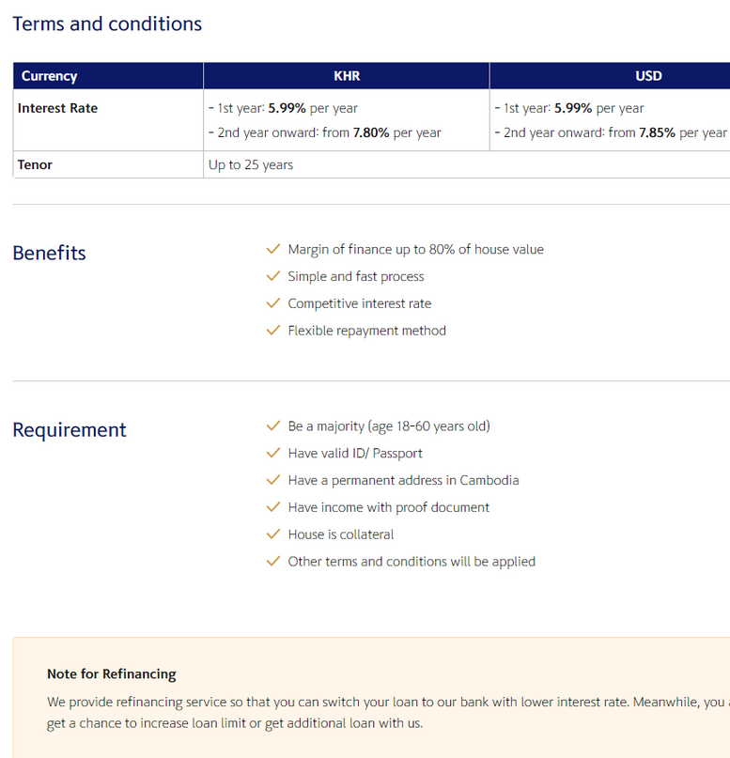
Here are some data needed for our project
PPCBANK
Shinhan
ACLEDA
Housing loan info
Housing loan info
LOAN SIZE, LOAN PERIOD, AND INTEREST RATE:
Loan size up to US$ 2000 - UP but not more than 80% of the house price.
Maximum the loan period is 20 years for:
Customers who are currently employed by public organizations, national or international agencies, and will not exceed the retirement age.
Other customers who have good health and will not be over 60 years of age (start from receiving the loan until the end of the loan period).
Interest rate 8.90% once per year.
CUSTOMER REQUIREMENTS:
Any Cambodian who is a majority
Having a proper work, salary, or business
Having good history, reputation, attitude, and willingness to pay back to PPCBank
Having a permanent address that is certified by the local authority
Having identity documents which are ID cards, family books, etc.
LOAN SIZE, LOAN PERIOD AND INTEREST RATE
Loan size up to US$ 300,000 but not more than 70% of the house price.
Maximum of loan period is 15 years for:
Customers who are currently employed by public organizations, national or international agencies, and will not exceed the retirement age.
Other customers who have a good health and will not be over 60 years of age (start from receiving loan until the end of loan period).
Interest rate from 9% to 10% per annum.
CUSTOMER REQUIREMENTS
Any Cambodian who is a majority
Having a proper work, salary, or business
Having good history, reputation, attitude and willing to pay back to ACLEDA Bank
Having a permanent address which is certified by local authority
Having identity documents which are ID card, family book, etc.

Slide 7



About House Information
In this part, KOH Tito and LAB Thavrith are responsible for the data scraping for house sale online. The purpose of this section is to show user to consider where and what type of house that they need to buy.
02

Slide 8
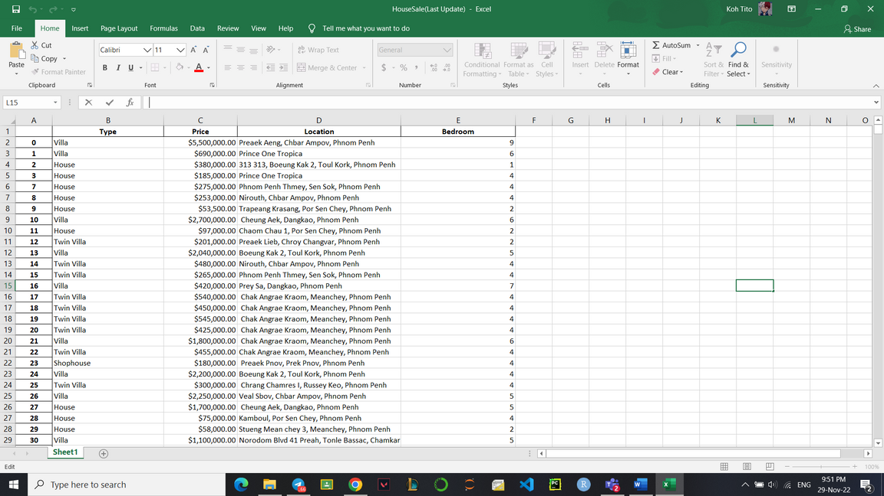
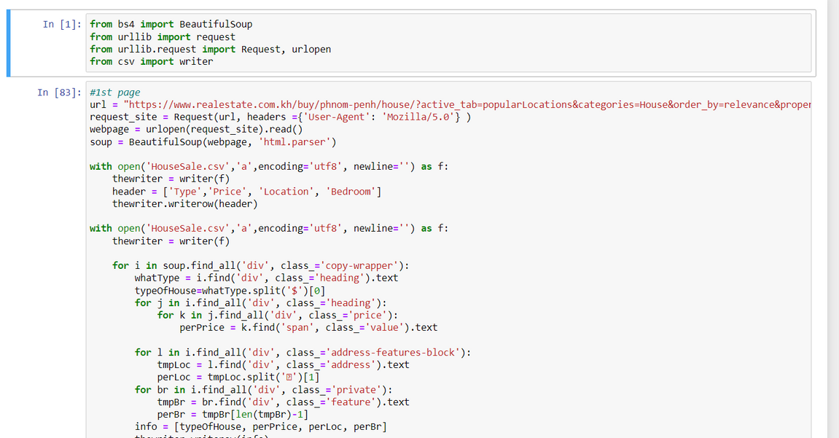
Here are some Data about House sale
13

Slide 9


Project's Flow
03

Slide 10
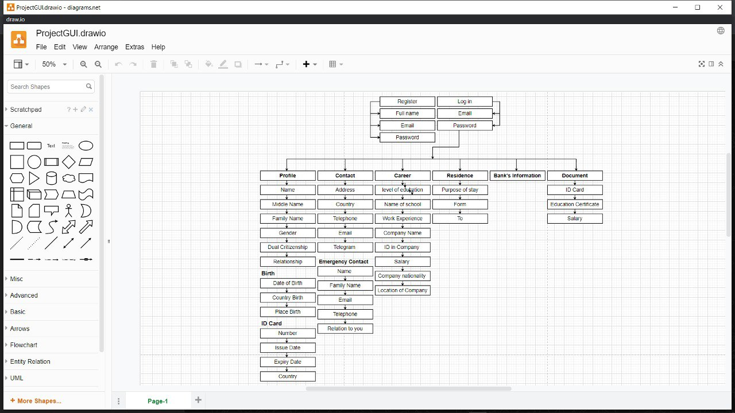
For the GUI

Slide 11
Next Step
Design the GUI or Website
Provide individual code writing part
A lot of meetings
Code assemble
04

Slide 12

Thank you
Cam refinance

